Slide 1
ROUND WEATHER LOUVER

Slide 2
4 Way Square Air Diffuser Ceiling

Slide 3
DAMPER DIFFUSER

Slide 4
ROUND DIFFUSER

Slide 5
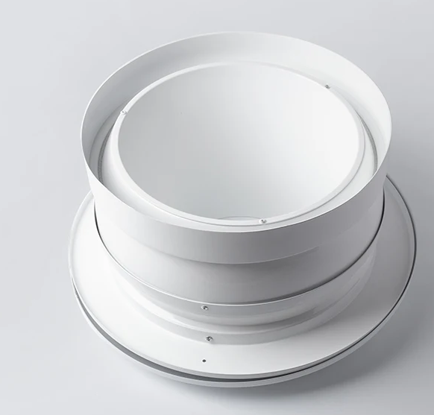
JET NOZZLE

Slide 6
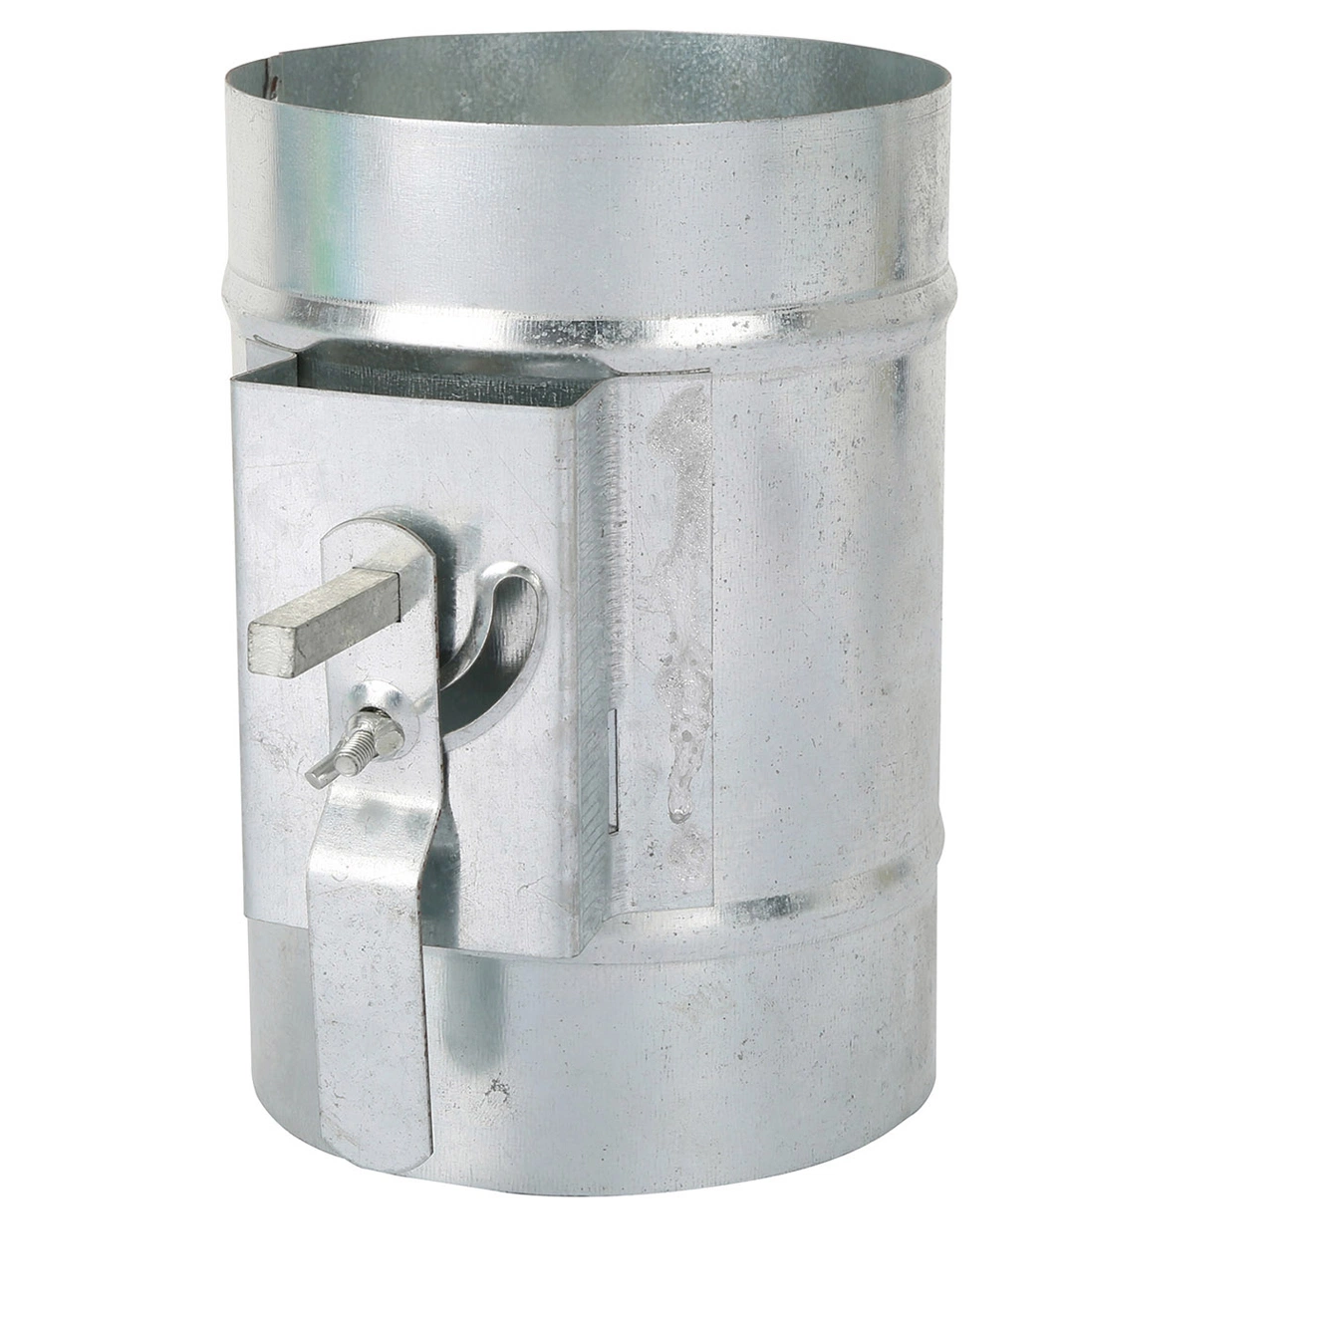
VOLUME DAMPER

Slide 7
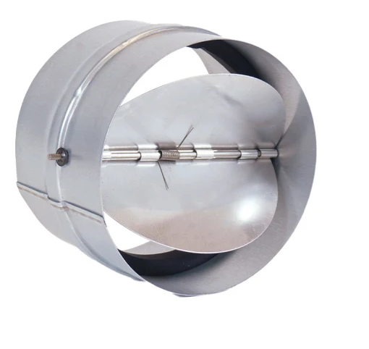
ONE WAY SHUTTER

Slide 8
LINEAR GRILL

Slide 9
PLASTIC DISC VALVE

Slide 10
METAL DISC VALVE

